Slide 1
El Fileteado de
Buenos Aires
Hazel Brown, SPAN 101
Notes:
áéíóúÁÉÍÓÚñÑ

Slide 2
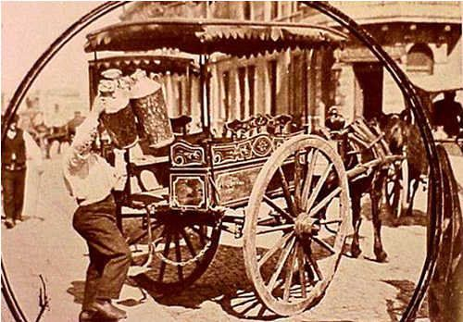
Lechero, 1900
Notes:
Lechero, 1900 (Pinterest)

Slide 3
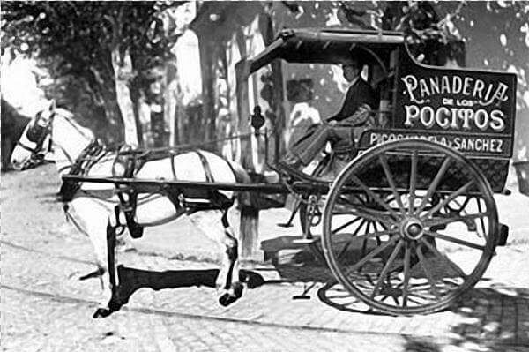
1930
Notes:
Montevideo, 1930

Slide 4
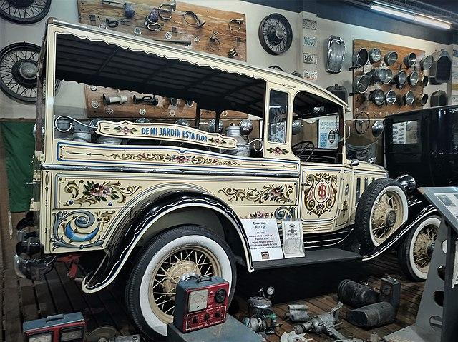
Notes:
1932

Slide 5
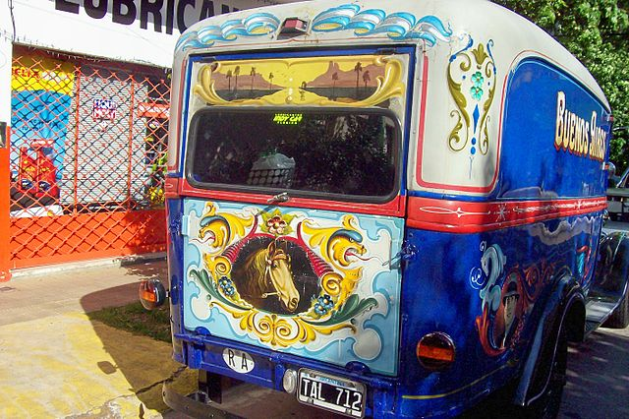
1931

Slide 6
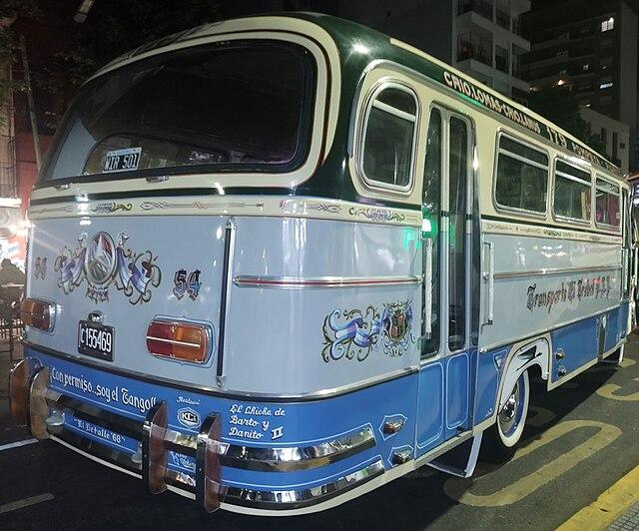
1970s

Slide 7
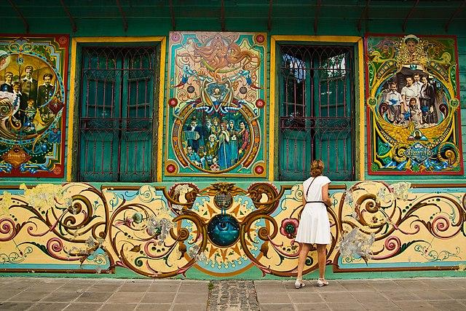

Slide 8
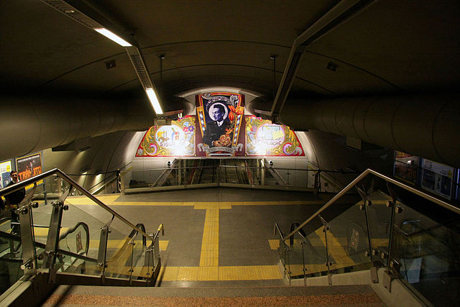

Slide 9
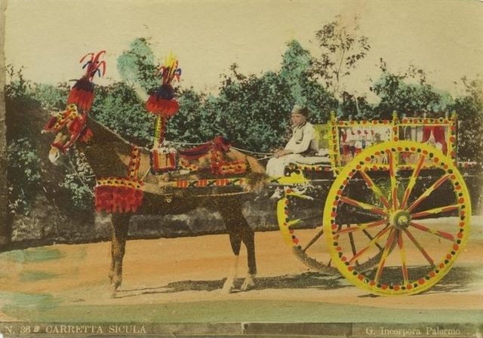
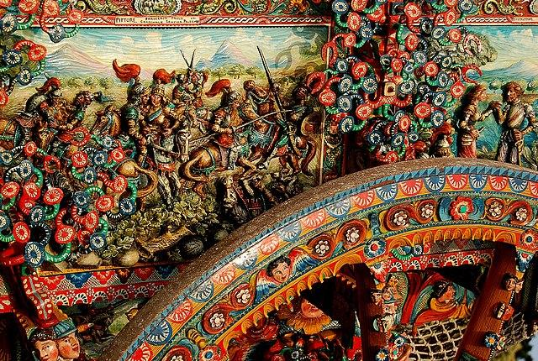
Lu carrettu sicilianu
Sicilianos desarrollaron un arte elaborado de adornar su carretes desde el décado 1880. Tomó inspiración del arte de las iglesias, y necesitaba cuatro especializaciones: un pintor, un tallador, un herrero y un carpintero.
Notes:
https://voca.ro/1kOmEhGXdAko
En el siglo diecinueve, más sicilianos estaban usando carretes para viajar y trabajar porque la sistema de caminos estaba desarrollado mucho más.
Para expresarse, desarrollaron un arte de adornarlos extravagantemente con pinturas y tallas. A menudo requirió cuatro especializaciones: un pintor, un tallador, un herrero y un carpintero.
Conocían el arte principalmente por las iglesias en sus villas, así que hay diversidad estilística entre regiones de Sicilia: cerca Palermu son amarillos y más influido por el arte árabe-normo, y cerca Catania son rojos y mas barrocos.

Slide 10
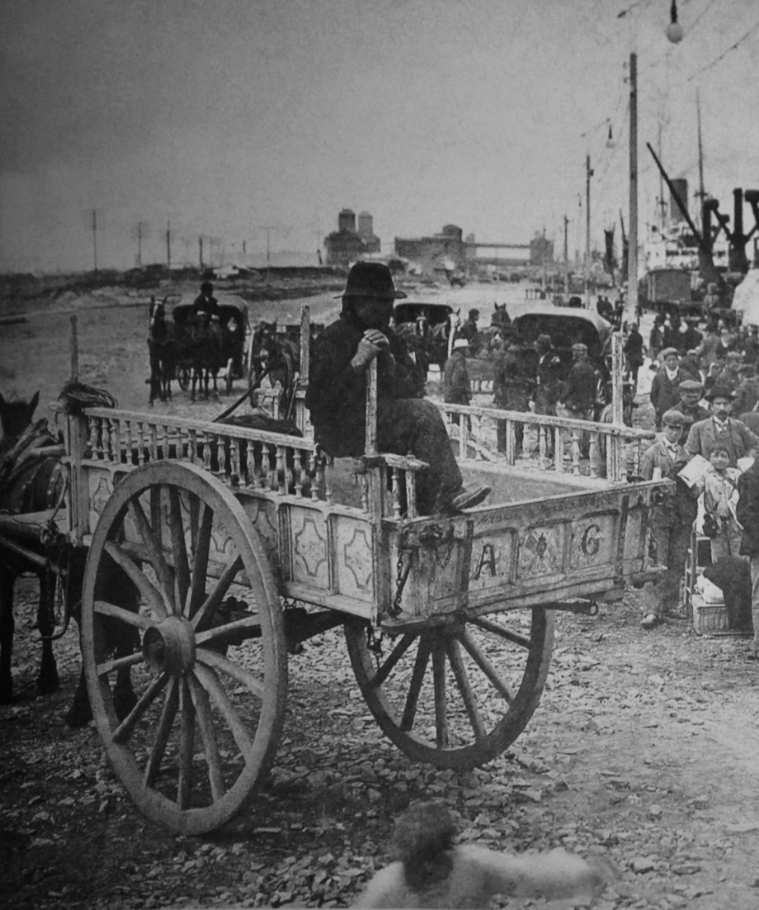
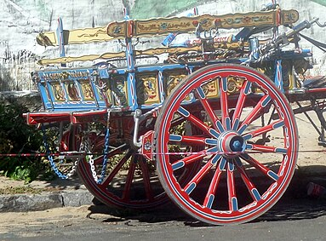
Los carretes argentinos

Slide 11
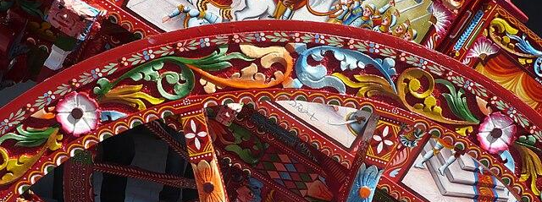

Yapán
En lugar del tallado, los carretos argentinos hacían profundidad por una técnica de sombreado llamado "yapán".
Notes:
En contrasto a sicilia, argentina estaba teniendo un auge económico y personas tenían oficios más modernos. En plaza del tallado, era práctico
Los carretti son como meditaciones en la majestad de las iglesias
El fileteado, acuerdo a mucho de sus maestros, es como
y la vida porteña es con ajetreo.

Slide 12
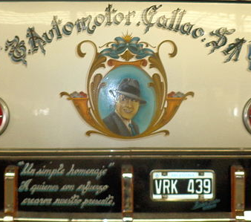
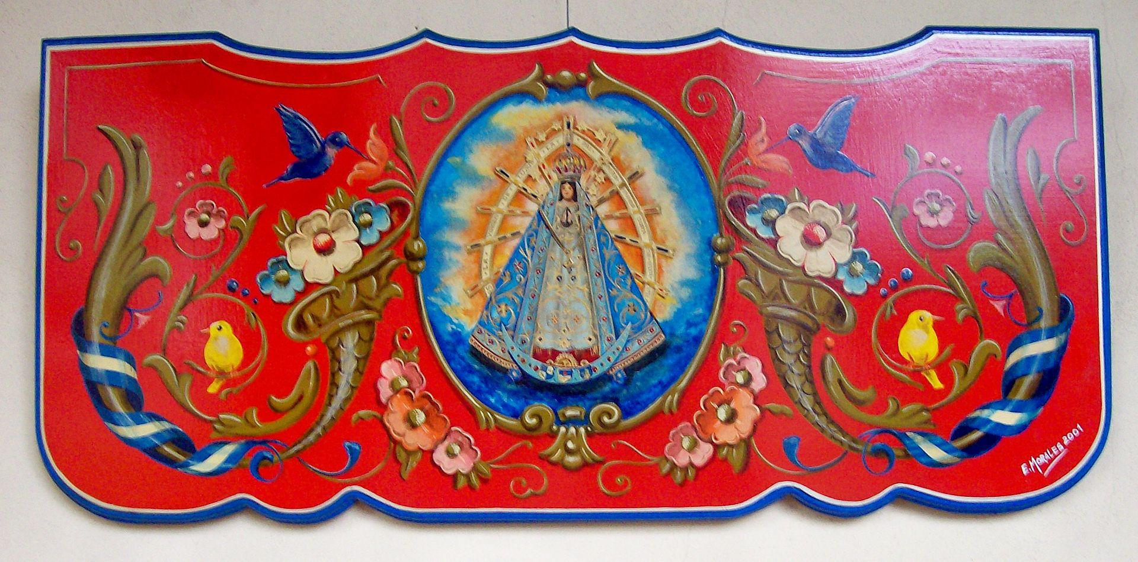
Motivos comunes
Entrejido con las florituras barrocas frecuemente son flores, animales y dragones, y cintas, usualmente en la tribanda argentina.
Notes:
https://voca.ro/1lFpRKlOHlwa
Entrejido con las florituras barrocas frecuemente son flores, animales y dragones, y cintas, usualmente en la tribanda argentina.
También se presentan personajes argentinos, especialmente Juan Perón, iconos religiosos, y proverbos.
Florituras barrocas
Cintas y banderas
Ribete fino
Flores
Animales
Personajes argentinos
Iconos religiosos
Proverbios y dichos sentidos
Fileteado siempre se pinta en fondos lisos, y donde dos regiones de color se unen, hay ribetes finos en líneas o curvas simples.
A menudo hay
Casi siempre las banderas son argentinas, pero ocasionalmente son de otros países.

Slide 13
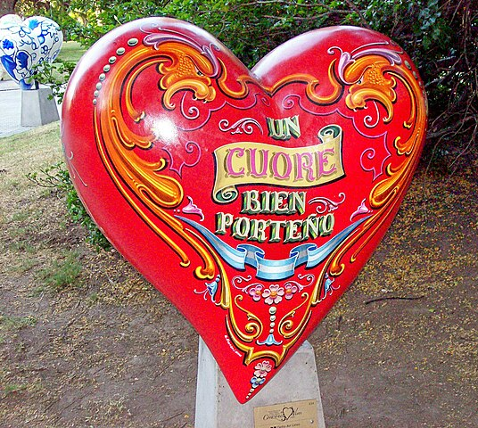
Icono de Buenos Aires
Instalación por Gustavo Ferrari a la exposición "corazones vivos", 2006

Slide 14
Reflection
I first learned about filete porteño when I was browsing UNESCO’s registry of intangible cultural heritage. I knew of its Buenos Aires origin and its general look prior to this project. The font reminded me of a commercial art style that invoked a turn of the century circus advertisements in America. However, the details and curves on the flowers and faces were much more artistically developed than the American advertisements. It seemed likely that these Argentine motifs were probably influenced by Italian pop culture. I had seen similar motifs in turn of the century Italian pop art as well as the flourishes in Italian Baroque art. I knew that Argentina had many Italian immigrants and wondered what the specific connection between these art styles were.
I am fascinated by Sicilian carrettu culture but before this project I did not know it had influence outside of Sicilian folk art. While researching this project I did not have opportunity to read peer reviewed articles or books on the history of fileteado, but found that an El País article connected its origins to the carrettu sicilianu.
The classic fileteado carts were different than the carretti: both were personalized artistic transformations of indispensable but mundane carts, but the fileteado carts were not as detailed. In the Sicilian countryside, the carretti were produced with intense details including every large planar surface featuring an elaborate historical painting, and beams including both carving and painting to add depth. Buenos Aires in contrast was a bustling major world port where residents had less time and space to spend on decorating carts.
As Americans, we are generally familiar with the problem of adapting an old culture to a new place, and appreciating what comes of these efforts. For example, everyone knows the pizza and pasta Americans enjoy is quite different from its Italian counterparts, and most also know that even the most traditional Italian recipes have made adaptations, and that Italian cooks can probably tell you what in particular (e.g. that true muzzarella is made from the milk of the Italian water buffalo).

Slide 15
Referencias
Ferrari, G. (n.d.). Fileteado. Fileteado Porteño. http://ferrarifileteados.com/fileteado

Slide 16
Except where otherwise noted, all images used in this presentation are sourced from Wikimedia and are in the public domain.

